Slide 1
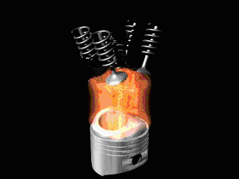
A Brief Theory on IC Engines

Slide 2
Engine Testing and Performance
Important Performance Parameters of I.C.Engines:-
The important performance parameters of I.C. engines are as follows:
(a) Power and Mechanical Efficiency.
(b) Mean Effective Pressure and Torque.
(c) Specific Output.
(d) Volumetric Efficiency.
(e) Fuel-air Ratio.
(f) Specific Fuel Consumption.
(g) Thermal Efficiency and Heat Balance.
(h) Exhaust Smoke and Other Emissions.
(i) Specific Weight.

Slide 3
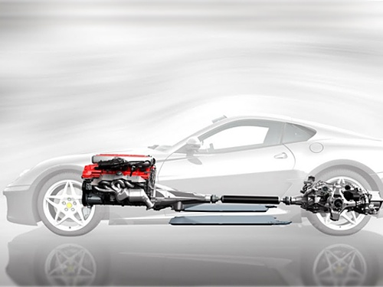
Engine Testing and Performance
Indicated Power (IP) = Brake Power (BP) - Friction Power (FP)
INDICATE POWER DEVELOPED INSIDE THE ENGINE: IP
POWER AVAILABLE AT THE END OF CRANK SHAFT: BP
FRICTION POWER: FP

Slide 4

Indicated Power
Power obtained at the cylinder. Obtained from the indicator diagram
where
P_{i} is the indicated mean effective pressure, in N/m
L is the stroke length, in m
A is the area of cross section of the piston, m²,
N’ is the engine speed in rev/min,
[=N’=N/2 for 4_S engine and N’=N for 2-S engine]
n is the number of cylinders and
For 4-stroke engine-one cycle will be completed in two revolutions N’=N/2
For 2-stroke engine-one cycle will be completed in one revolutions N’=N

Slide 5



Mean Effective Pressure
The mean effective pressure is a quantity related to the operation of an reciprocating engine and is a valuable measure of an engine's capacity to do work that is independent of engine displacement
Indicated Mean Effective Pressure or imep (pi) - it may be defined as the average pressure over a cycle in the combustion chamber of the engine.
P_{i} = (Net work of cycle)/Swept Volume in N/m² = P mep = Pm = Pi
Let,
W = work per cycle in joule
P = power output in watt
p_{mep} = mean effective pressure in pascal
V_{d} = displacement volume in cubic metre
n_{c} = number of revolutions per cycle (for a 4-stroke engine n_{c} = 2)
N = number of revolutions per second
T = torque in newton-metre
also
  W = p_{mep} * V_{d}
so
Since
  P = TN2π

Slide 6
Mean Effective Pressure
is also obtained by engine indicator diagram as
Pm= Pmep = (s*a)/l = N/m²
Where:
a = actual Indicator diagram cm2
l = base width of the indicator diagram, cm
s = spring value or spring constant used for in indicator diagram,( N/m² )/cm
Brake mean effective pressure (BMEP) - Mean effective pressure calculated from brake torque

Slide 7
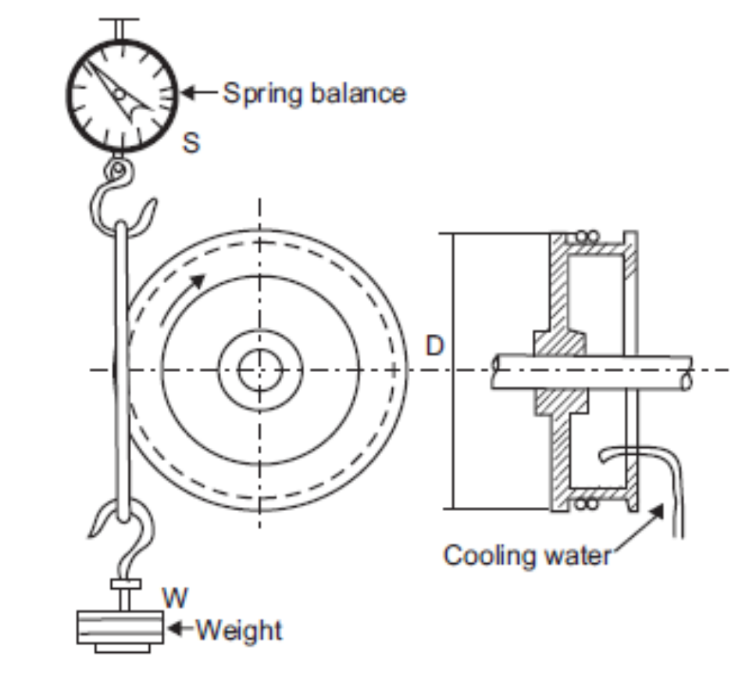
Brake Power
MEASUREMENT OF B.P
1. Mechanical Dynamometer
Prony Brake
Rope Brake
  BP = 2.π.N.T / 60 Watts
T = Torque = (W-S) D_{e}/2
W = Load on the Brake Drum in N
S = Spring Balance Reading in N
De = Effective Brake Drum Diameter = Drum Diameter(Db) + (2*Thickness of Rope)
BP can also be written as
  BP = (W-S) (Db +d)π.N / 60 in Watts
Π (Db+d) is circumference of the brake drum

Slide 8
Friction Power
Friction power includes the frictional losses and the pumping losses. During suction and exhaust strokes the piston must move against a gaseous pressure and power required to do this is called the “pumping losses”.
The friction loss is made up of the energy loss due to friction between the piston and cylinder walls, piston rings and cylinder walls, and between the crank shaft and camshaft and their bearings, as well as by the loss incurred by driving the essential accessories, such as
water pump, ignition unit etc.

Slide 9

This method can be used only for multi – cylinder IC engines
The test consists of making, in turn, each cylinder of the engine inoperative and noting the reduction in brake power developed.
In a petrol engine (gasoline engine), each cylinder is rendered inoperative by “shorting” the spark plug of the cylinder to be made inoperative. In a Diesel engine, a particular cylinder is made inoperative by cutting off the supply of fuel
It is assumed that pumping and friction are the same when the cylinder is inoperative as well as during firing.

Slide 10
In this test, the engine is first run at the required speed and the brake power is measured.
Next, one cylinder is cut off by short circuiting the spark plug if it is a petrol engine or by cutting of the fuel supply if it is a diesel engine. Since one of the cylinders is cut of from producing power, the speed of the engine will change.
The engine speed is brought to its original value by reducing the load on the engine. This will ensure that the frictional power is the same.
Total indicated power when all the cylinders are working
n
= ip1 + ip2 + ip3 + …………...+ ipn = ∑ ip j
j = 1

Slide 11
n
We can write ∑ IPj = (BP)t + (FP)t ………………………………………..(1)
j= 1
Where IPj is the indicated power produced by j th cylinder, n is the number of cylinders,
(BP)t is the total brake power when all the cylinders are producing power and (FP)t is the total frictional power for the entire engine.
If the first cylinder is cut – off, then it will not produce any power, but it will have frictional losses. Then
n
we can write ∑ IPj = (BP)1 - (FP)t………………………………………..(2)
j=2
where (BP)1 = total brake power when cylinder 1 is cut - off and (FP)t = Total frictional power.
Subtracting Eq. (2) from Eq. (1) we have the indicated power of the cut off cylinder. Thus

Slide 12
(IP)1 = (BP)t – (BP)1 ………………………………………..(3).
Similarly we can find the indicated power of all the cylinders, viz., ip2, ip3, …..ipk.
Then the total indicated power is calculated as
k
(IP)total = ∑ IPj ……………………………………….(4)
j=1
The frictional power of the engine is therefore given by
(FP)t = (IP)total – (BP)t

Slide 13
MORSE TEST
Morse Test is applicable to multi-cylinder engines. The engine is run at desired speed and output is noted. Then one of the cylinders is cut out by short circuiting spark plug. Under this condition other cylinders “motor” this cut cylinder. The output is measured by keeping speed constant to original value. The difference in output is measure of the indicated power of cut-out cylinder. Thus for each cylinder indicated power is obtained to find out total indicated power
Let,
BP = Brake Power when all cylinders are in working condition.
BP₁ = Brake Power when first cylinder cut-off.
BP₂ = Brake Power when second cylinder cut-off.
BP₃ = Brake Power when third cylinder cut-off.
IP = Indicated Power of Engine
IP₁ = Indicated Power of first cylinder
IP₂ = Indicated Power of second cylinder
IP₃ = Indicated Power of third cylinder
FP₁, FP₂, FP₃ = Friction power of each cylinder

Slide 14
When, All cylinders in working condition,
IP = (IP1 + IP2 + IP3) …………………………………………………………………(i)
BP = (IP1 + IP2 + IP3) – ( FP1+ FP2 + FP3 ) ……………………………………….….(ii)
First Cylinder Cut-off,
BP1 = (IP2 + IP3) – ( FP1+ FP2 + FP3 ) ………………………………………………. (iii)
Where, ( FP1+ FP2 + FP3 ) in above both eqs.(ii)&(iii) remains almost constant at constant speed. Subtracting Eq.(iii) from Eq.(ii), We get, Indicated Power of first cylinder,
IP1 = (BP - BP1) …………………………………………………………………….(iv)
Similarly, Indicated Power of second cylinder
IP2 = (BP - BP2) ……………………………………………………………………..(v)
Indicated Power of third cylinder
IP3 = (BP - BP3) …………………………………………………………………….(vi)
Putting the values of IP1, IP2, IP3¬ in eq.(i),we get,
IP = (BP - BP1) + (BP - BP2) + (BP - BP3) ………………………………….……(vii)
Frictional Power, FP = ( IP – BP ) ……………………………………………………………………(viii)

Slide 15
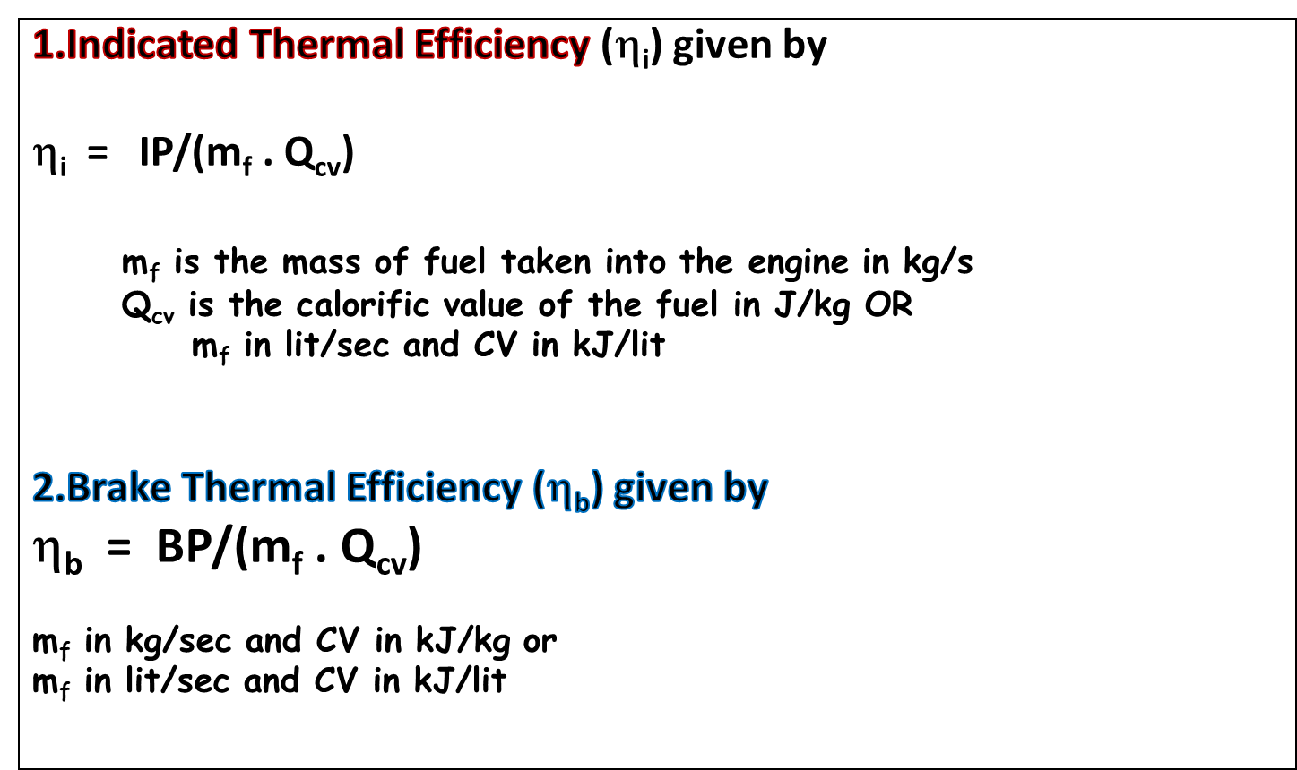
Efficiencies

Slide 16
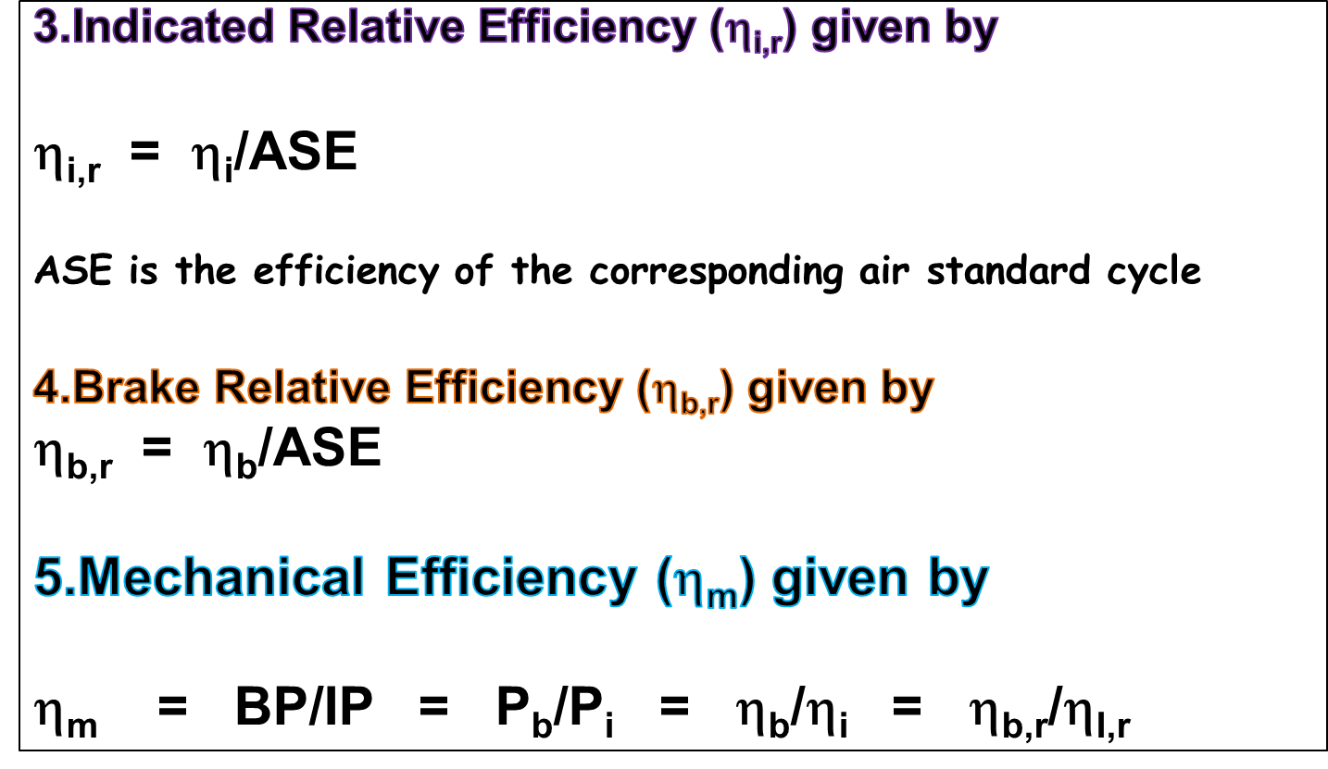
Efficiencies

Slide 17

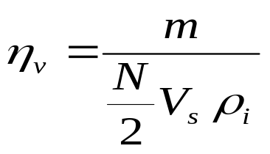
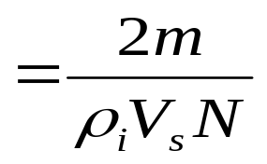
Indicates air capacity of a 4 stroke engine.
ήvol = Actual Air Admitted at intake condition / Theoretical Volume Available(Vs)
Volumetric efficiency of an engine is an indication of the measure of the degree to which the engine fills its swept volume.
It is defined as the ratio of the mass of air inducted into the engine cylinder during the suction stroke to the mass of the air corresponding to the swept volume of the engine at atmospheric pressure and temperature.
Alternatively, it can be defined as the ratio of the actual volume inhaled during suction stroke measured at intake conditions to the swept volume of the piston.
m-- is the mass flow rate of fresh mixture.
N-- is the engine speed in rev/unit time.
V_{s} --is the piston displacement (swept volume).
ρ_{i----} is the inlet density.

Slide 18
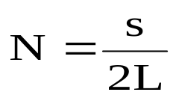
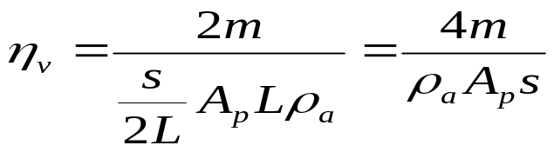
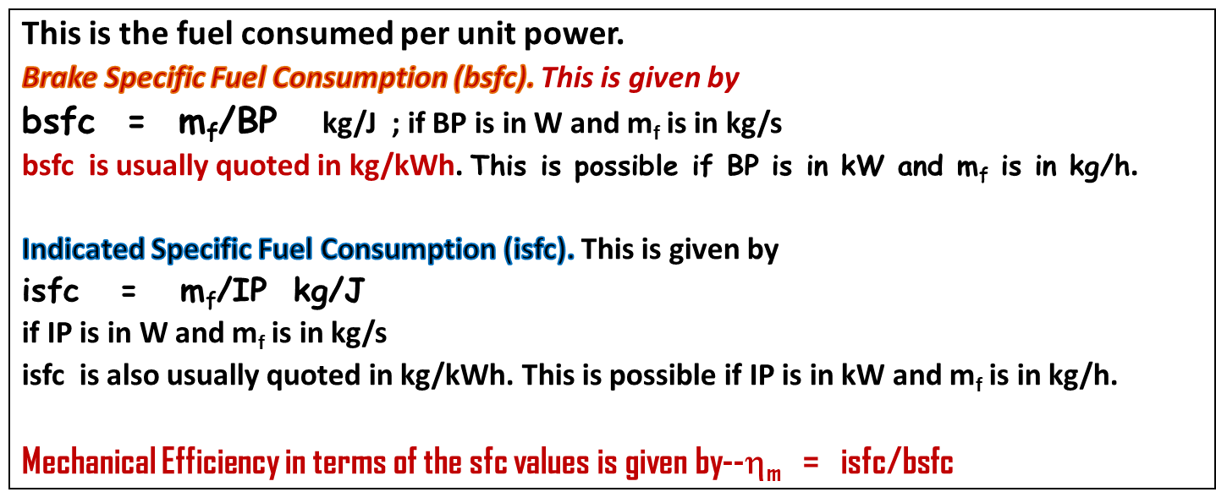
Also Vs = A_{p}L = s = 2LN
L is the piston stroke and s is the linear piston speed (m/s).
Specific Fuel Consumption

